Slide 1
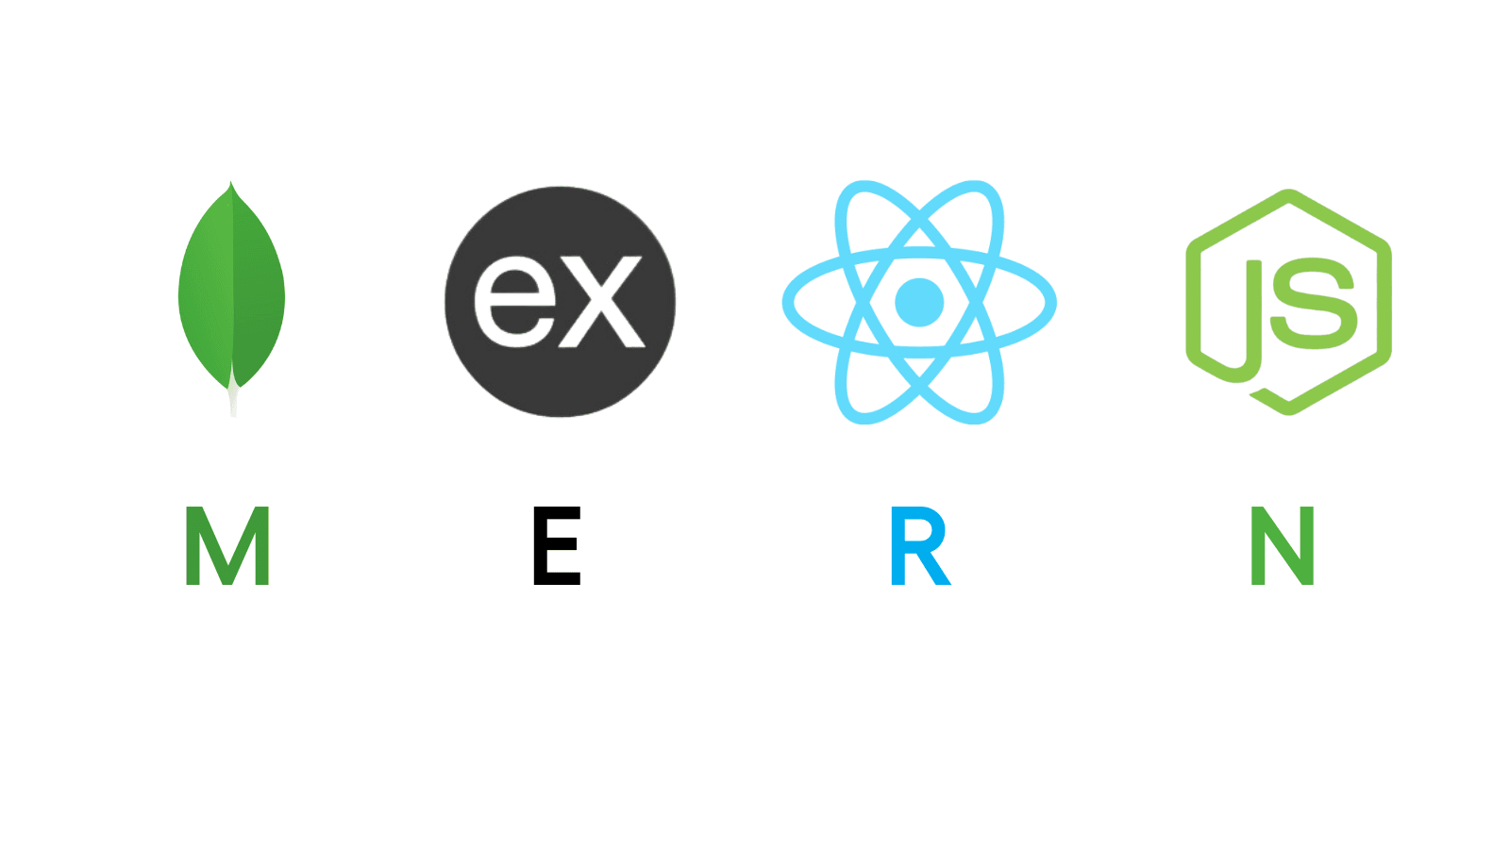
MERN STACK DEVELOPMENT
Full stack development course
By -Arpit Gaveshinde

Slide 2
Prerequisites for MERN Stack Development
HTML
CSS
JAVASCRIPT

Slide 3
INTRODUCTION
MERN stands for MongoDB, Express, React, Node, after the four key technologies that make up the stack that is used for easier and faster deployment of full-stack web applications.
  MongoDB - document database
  Express(.js) - Node.js web framework
  React(.js) - a client-side JavaScript library
  Node(.js) - the premier JavaScript web server

Slide 4
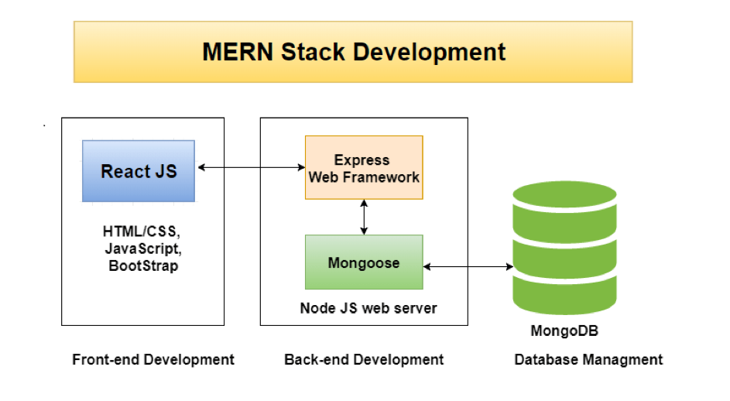

Slide 5
How does the MERN Stack work?
The MERN architecture allows you to easily construct a 3-tier architecture (frontend, backend, database) entirely using JavaScript and JSON.

Slide 6
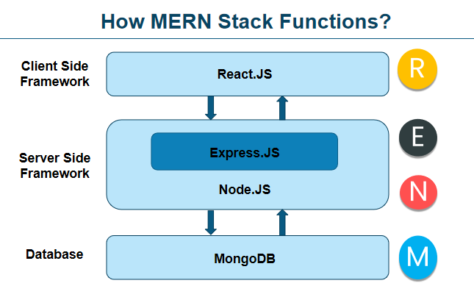

Slide 7


Slide 8
MongoDB
NoSQL database used for high-volume data storage.
Open-source document-oriented database.
MongoDB is written in C++.
It stores data in JSON format.
Can be easily used with Node.
Documents containing key-value pairs are the basic units of data in MongoDB.

Slide 9
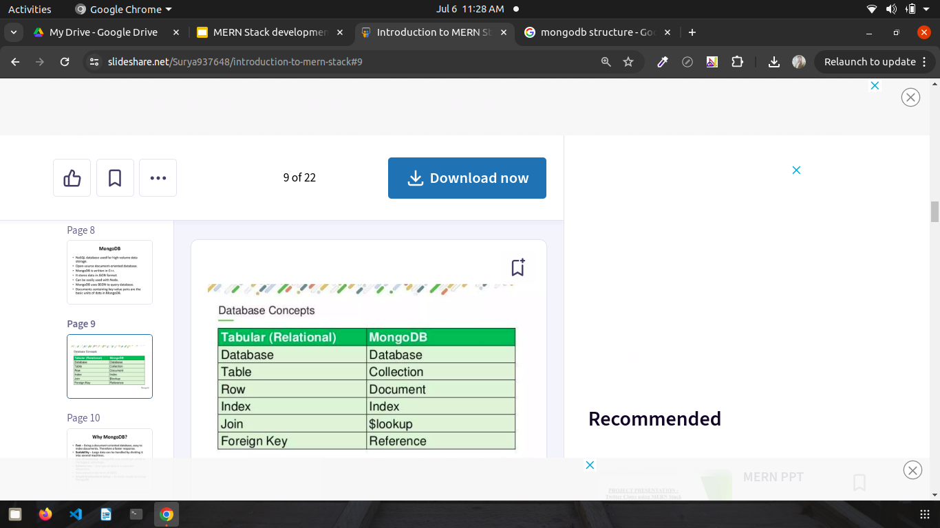
Database Concept

Slide 10
Why MongoDB?
Fast - Being a document-oriented database, easy to index documents. Therefore a faster response.
Scalability - Large data can be handled by dividing it into several machines.
Use of JavaScript - MongoDB uses JavaScript which is the biggest advantage.
Schema Less - Any type of data in a separate document.
Data stored in the form of JSON.
Simple Environment Setup - Its really simple to set up MongoDB.

Slide 11
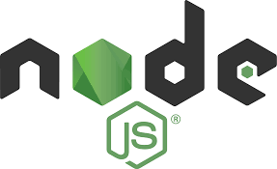

Slide 12
NodeJS
JavaScript run-time environment built on Chrome's V8 JavaScript.
Node.js allows you to run JavaScript on the server.
It is free & open source, written in C++.
Ryan Dahl developed Node.js in 2009. He embedded C++ code with Chrome's V8 Engine and gave the name as Node.js.
Node.js runs single-threaded, non-blocking, asynchronous programming, which is very memory efficient.

Slide 13
Where to use Node JS?
Back-end services such as APIs.
Highly scalable, data-intensive and real-time apps.
I/O bounds applications.
Single page applications.
Where not to use Node JS?
Node.js is not used in CPU-intensive apps which requires calculations done by CPU.

Slide 14


Slide 15
ExpressJS
Flexible Node.js framework that provides robust set of features for web and mobile application.
It provides easy routing of requests based on HTTP methods and URLs.
It allows to set up middlewares to respond to HTTP Requests.
Allows to dynamically render HTML Pages based on passing arguments to templates.

Slide 16
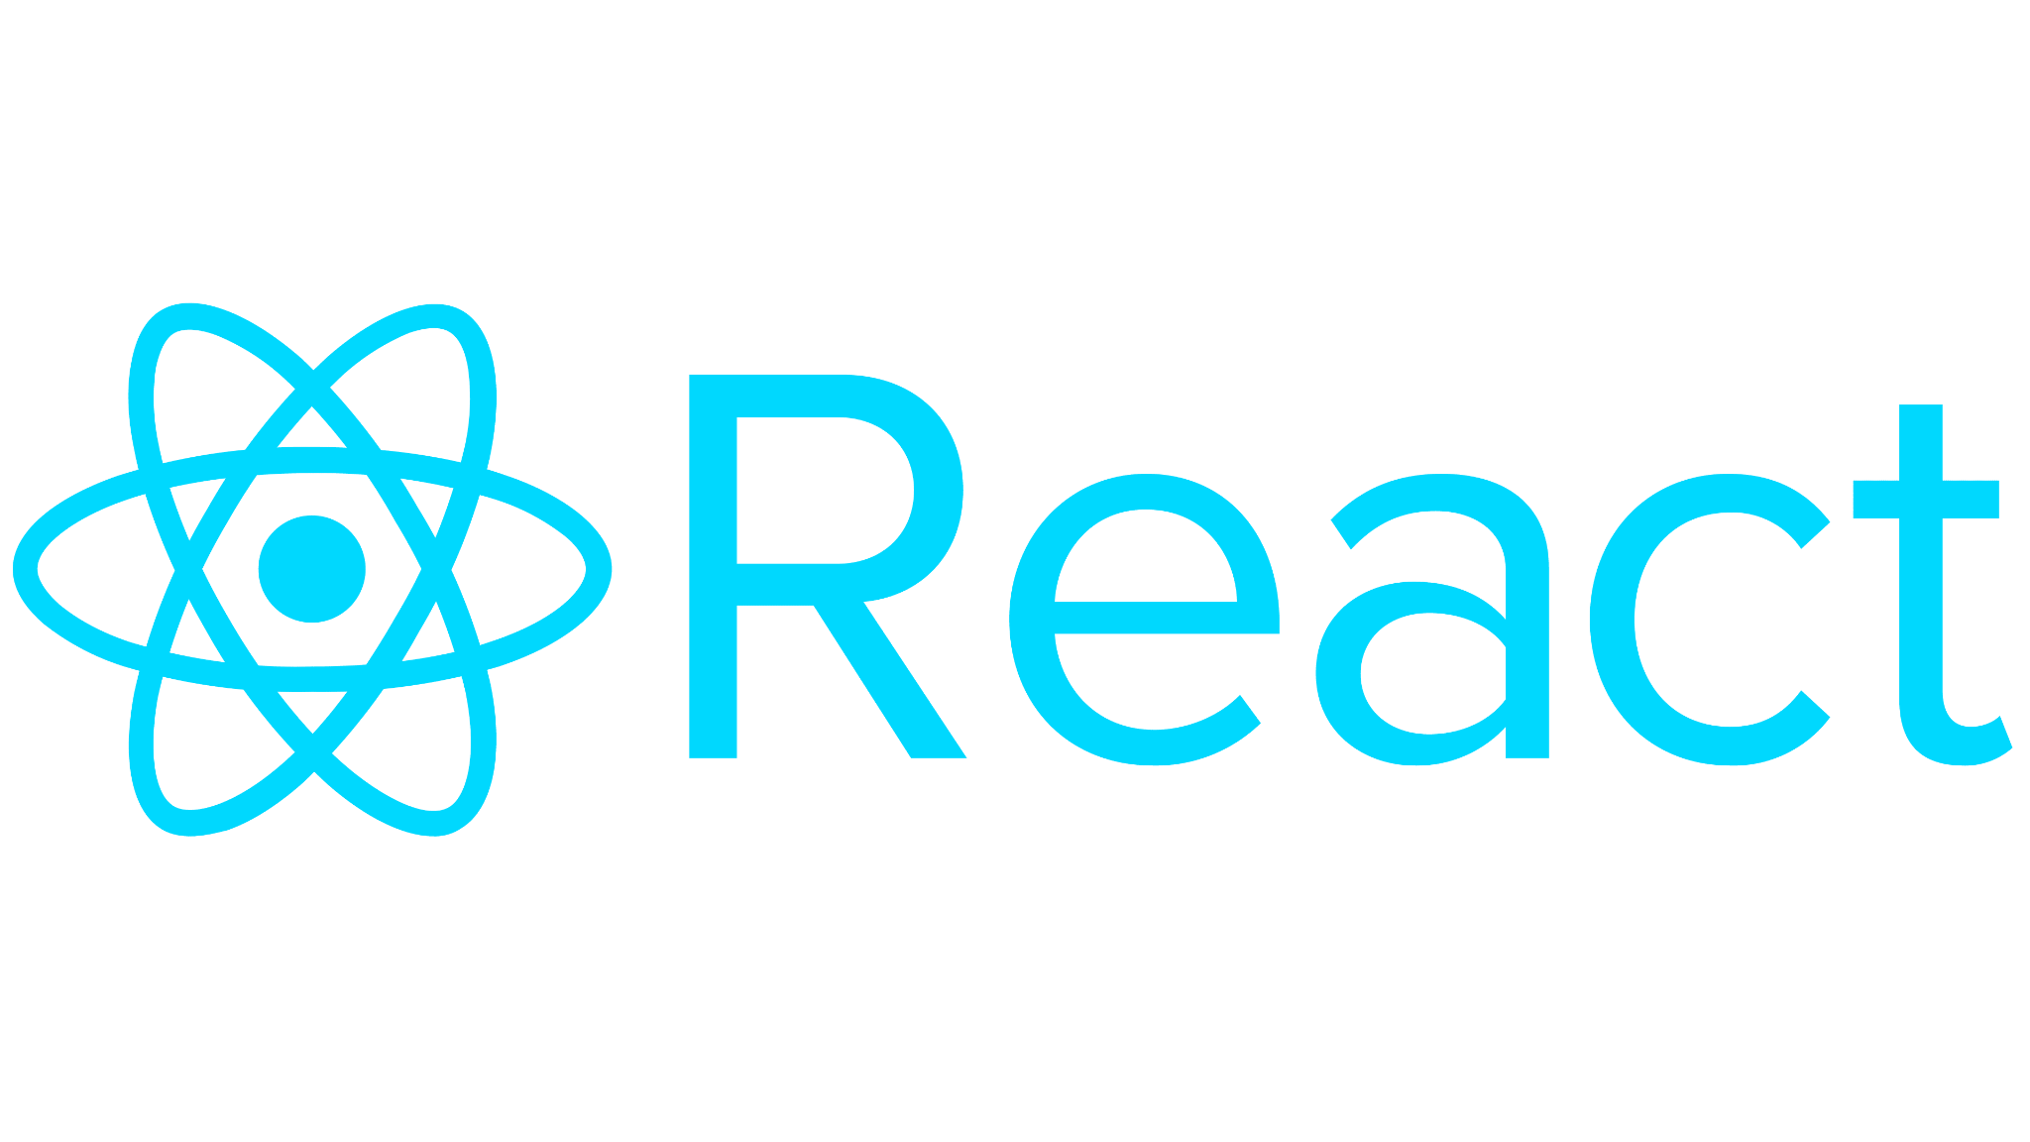

Slide 17
ReactJS
A JavaScript library for building user interfaces for web and mobile applications.
React is used to build single-page applications.
React allows us to create reusable UI components.
React-router to handle the front-end routing.
React was created by Jordan Walke, a Software Engineer at Facebook.

Slide 18
Why to use React?
JSX (JavaScript XML) makes it easier and simpler to write React components.
ReactJS supports Components. These components also promote code reusability and make the overall web application easier to understand and debug.

Slide 19
How does React work?
Instead of manipulating the browser's DOM directly, React creates a Virtual DOM in memory, where it does all the necessary manipulating, before making the changes in the browser DOM.
React finds out what changes have been made, and changes only what needs to be changed

Slide 20
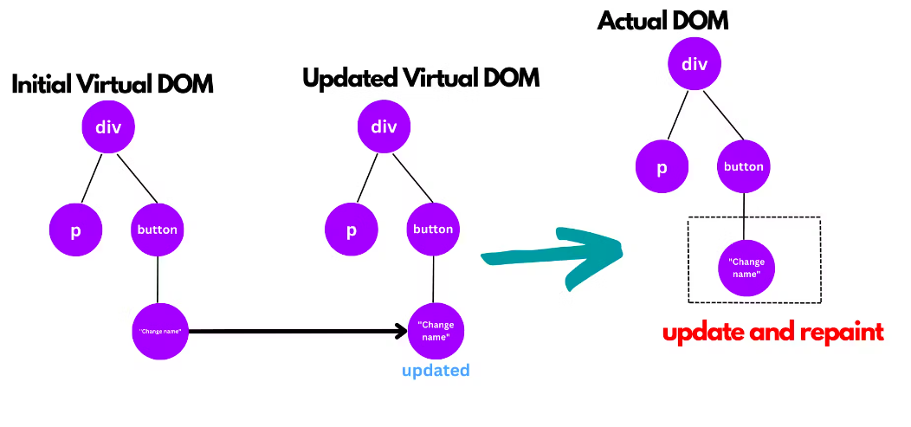

Slide 21
References
https://www.mongodb.com/
https://expressjs.com/
https://reactjs.org/
https://nodejs.dev/

Slide 22
Thank You

